Slide 1

V
CALL
BY :
Lucky Verma (2115800014)
Mansi Sinha (2115800016)

Slide 2
Table of Content
Introduction
Features
Benefits
Working
Use Cases
Technologies Used

Slide 3

What is VCall?
VCall is a state-of-the-art video conferencing platform, designed to facilitate communication and collaboration in a digital landscape. Our platform offers a comprehensive suite of features that caters to various needs, whether you're hosting virtual business meetings, conducting online classes, or connecting with friends and family.

Slide 4

Features of Vcall
High-Quality Video Conferencing
Screen Sharing
Chat Functionality
User-Friendly Interface
Cross-Platform Compatibility

Slide 5
What are the benefits of vcall?
Flexible Communication
Cost-Effective Collaboration
Time Efficiency
Increased Productivity
Scalability
User-Friendly Interface

Slide 6
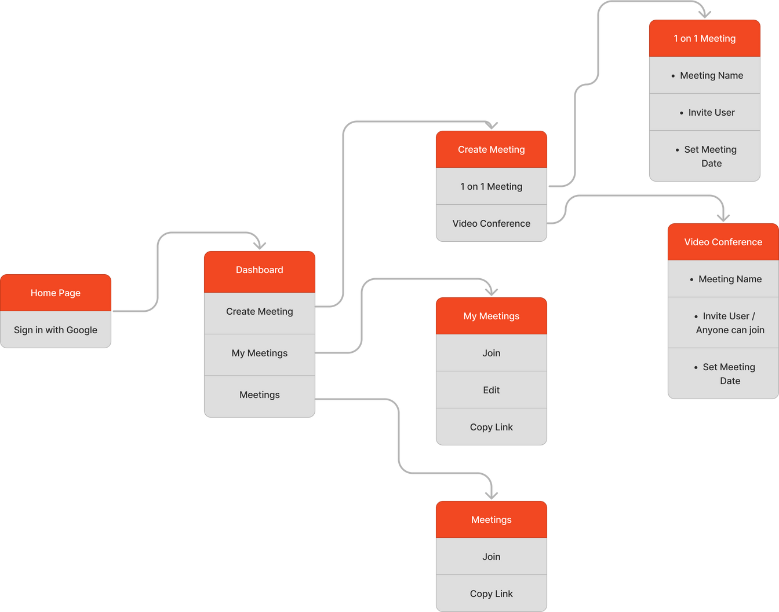
Working

Slide 7

Working

Slide 8
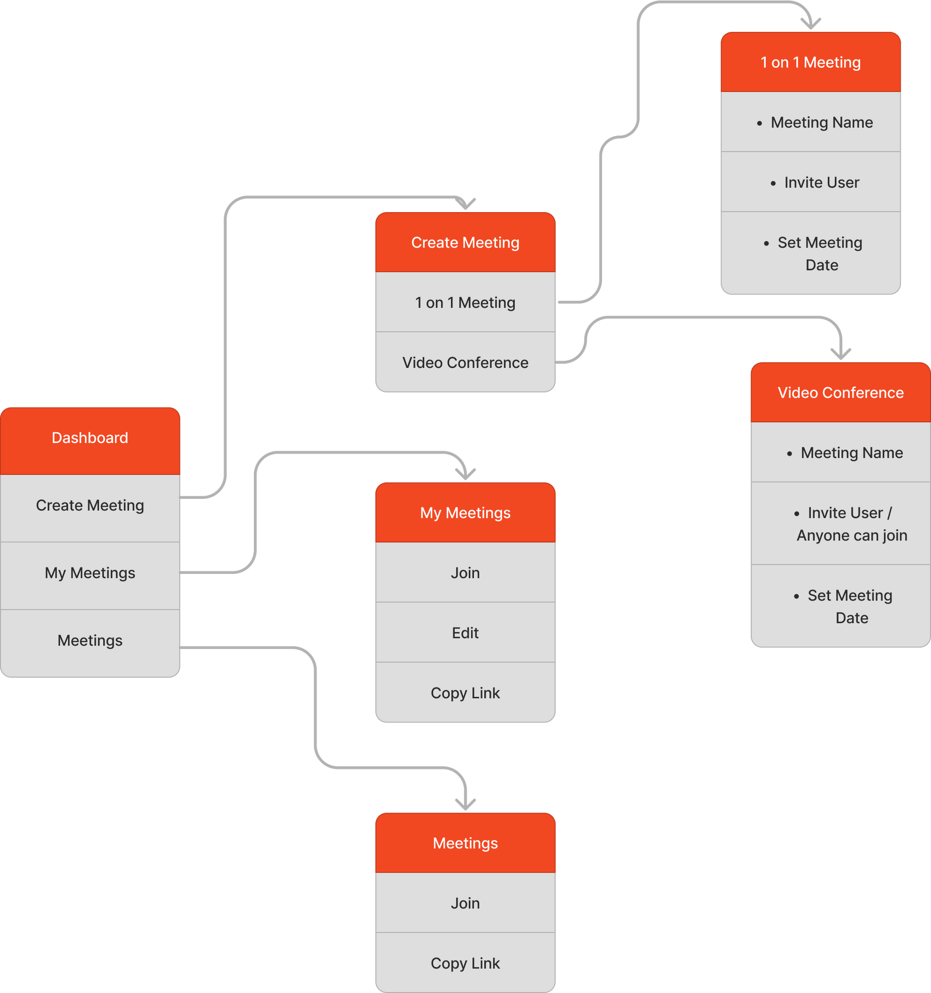
Working

Slide 9

Working

Slide 10
Use Cases of Vcall
Business Meetings
Remote Work
Online Classes and Education
Webinars and Conferences
Healthcare Telemedicine
Job Interviews
Family and Friends Meetings
Support and Customer Service
Training Sessions
Project Collaboration

Slide 11




Technologies Used

Slide 12
Future Work
Virtual Backgrounds
Recording and Playback
Breakout Rooms
Polls and Surveys
AI-Powered Noise Cancellation
File Sharing

Slide 13
Conclusion
VCall is a versatile virtual communication platform that transcends borders, fostering seamless collaboration across industries. With its user-friendly interface and advanced features, VCall facilitates efficient remote work, online education, and healthcare telemedicine, among other applications. Its adaptability and benefits, such as flexible communication and personalized settings, position it as a valuable tool in the evolving landscape of virtual interactions, shaping the way we connect and collaborate in a digital era.

Slide 14
THANK YOU

